Slide 1
IDENTIFIER RULES
Can use a-z,A-Z,_,$,0-9
First digit can't be 0-9
Can't use reserved names like if, for, int, float etc.
Can use class names like String, StringBuffer etc. but not recommended.

Slide 2
Keywords
USED KEYWORDS
UNUSED KEYWORDS
DATA TYPES | FLOW | MODIFIERS | EXCEPTION | CLASS | OBJECT | OTHER
Byte | if | public | try | class | new | void
Short | else | private | catch | extends | instanceof | enum
int | switch | protected | finally | implements | super
long | case | static | throw | interface | this
float | default | final | throws | package
double | while | abstract | assert | import
boolean | do | synchronized
char | for | native
 | break | strictfp
 | continue | transient
 | return | volatile
goto
const
RESERVED LITERALS
true
false
null

Slide 3
IS JAVA STATICALLY TYPED ?
Yes BECAUSE the type of the variable is checked at the compile-time of the code HENCE called a statically typed language.
Code won’t be compiled until error is corrected.
IS JAVA STRONGLY TYPED ?
Yes BECAUSE the type of the variable Should be specified by the programmer.
IS JAVA OBJECT ORIENTED?
No because primitive data types are used & MULTIPLE inheritance, operator overloading features not available.

Slide 4
DATA TYPE RANGE
byte -> 1 byte
short -> 2 byte
int -> 4 byte (declaration int hex = 0xa [=10]or int oct = 010[=8] or int bin=0b111[=7] )
long -> 8 byte (declaration long l = 20L )
float -> 4 byte (declaration float f = 20.0f)
double -> 8 byte (declaration double d = 1.2e9 [=1.2*10^9])
boolean -> compiler dependent(1 bit)
char -> 2 byte (declaration can be char x = 97)
Ex:- int x = 11_11_1; o/p-> x=11111
double x = 11_11.11_11; o/p-> x=1111.1111
But double y = 11_11.11_; =>error

Slide 5
SPECIAL CHARACTERS
\n -> newline
\b -> backspace (points cursor in one back direction)
\r -> carriage return (returns to position in a given line)
\t -> tab
\’ -> single quote
\” -> double quote
\\ -> backslash

Slide 6
ARRAYS
int x[] = new int[size]; size= 0 to Integer.MAX_VALUE
int x[][] = new int[size1][size2]; size1*size2= 0 to Integer.MAX_VALUE
Can also declare like this => int x[][] = new int[size1][]; & then do as follows x[0] = new int[3]; x[1] = new int[2]; … till x[size1-1] = new int[4]
Can also declare like this => int x[] = {1,2,3}; or int x[][] = {{1,2},{1,3,4}}
And int x[]; x = new int[2]; is valid But int x[]; x = {1,2,3}; is invalid.
To get length final variable length is used.
If we have x as 2D array then to get the length of entire array we must use x[0].length+x[1].length[]+x[2].length+…+x[n-1].length
If we use x.length then we will get n but not the number of elements in the array.
Anonymous arrays can be created while passing parameters or other cases like fun(new int[2][2]{{1,2},{1,3}}) and also like int x = new int[3]{1,2,3} or x=new int[]{1,2,3} (now it is not anonymous any more) etc.

Slide 7
VARIABLES
We can categorizes variables under 2 division-
Division1 -> 1)Primitive(doesn’t have property like an object) 2)Reference
Division2 -> 1)instance(heap area) 2)static(heap area) 3)local(stack area)
Default values of instance and static variables are as follows -
1)Numbers =0 2)references=null 3)Boolean=false so don’t need to initialize.
Local variables don’t have default values so they must be initialized. If not while printing or adding value etc. you will get error.
Local variables also cannot be used with any modifiers except final. i.e final int x = 20 is valid.
If we have instance/static variable like these 1) int x[]; 2)int x[] = new int[3] in 1) will get null pointer exception if accessing x[0] 2)will give 0 if accessed x[0].

Slide 8
VARARGS
public static void main(String[] args) {
m1();// or m1(1,2,3)
m2(new int[]{}); // or m2(new int[]{1,2})
}
public static void m1(int... x){
for(int i = 0; i < x.length; i++)System.out.print(x[i]+" ->");
}
public static void m2(int[] x){
for(int i = 0; i < x.length; i++)System.out.print(x[i]+" ->>");
}

Slide 9
MAIN METHOD
1)public -> To be accessible to JVM from anywhere
2)static -> To be able to call main without creating object
3)void -> not returning anything to JVM
4)main -> name of the function called by JVM
5)string []args -> accepts input runtime
i.e. when using command [ java filename arg1 arg2 arg3 so on ] can be used to get arguments run time & to access these args just use args[i].
Overloading of main will be done but string[] args one will be called.
Overriding is possible(called method hiding as at compile time itself the method is resolved) hence child main will be called.
final, synchronized, strictfp are the only modifiers that can be used with main method.
Without main method error occurs.
Parameter -> method variables Argument -> variables/values passed while calling method

Slide 10
++ Operator usecase
1)byte b = 10; b = b+1; error (Since byte + int = int)
2)byte b = 10; b++; o/p →b=11
3)byte b = 10; b = (byte)(b+1); o/p → b=11
In 1) compiler thinks that operation is on int hence returns int result but in 2&3) compiler performs operation and then converts back to byte.
Basically compile returns maximum data type result after computing.
Ex: public class Main{
public static void main(String[] args) {
long value = 10;
value = value + Integer.MAX_VALUE;(long + int = long)
System.out.println(value); O/P→ 2147483657
}
}

Slide 11
JAVA STANDARD
Class name, interface name starts with capital letter & camel casing followed.
Variable name, method name starts with small letter & camel casing followed.
Constants are separated by underscore & all letter are capital.
SAMPLE EXAMPLES
SOP(10/0) -> RE:ArithmeticException
SOP(10.0/0.0) -> Infinity
SOP(-10.0/0)-> -Infinity
SOP(0.0/0) -> Nan
SOP(-0.0/0) -> Nan
NOTE :- Only operator overloaded in java is ‘+’ operator for arithmetic & string concatenation.

Slide 12
== VS .equals in String
== basically compares if the two references are pointing to the same object or not, if yes then it returns true.
.equals checks the content pointed by two references & if they are equal then return true.
Ex :
String str1 = new String(“abc”);
String str2 = new String(“abc”);
System.out.println(str1==str2);// O/P-> false
System.out.println(str1.equals(str2)); O/P-> true
If new String was not used then at run time actually str1 will be pointing to str2 so that time it would give true in both cases. So new was used.

Slide 13
“instanceof” METHOD
Used to check if a particular reference is an instance of the class specified.
Here one of the reference and class name should be either child/ parent of the other. Else it will throw CE saying incompatible types.
Ex :- (We know that Object->Person>Student [Parent→→child order])
Person p = new Person();
System.out.println(p instanceof Object);//true
System.out.println(p instanceof Person);//true
System.out.println(p instanceof Student);//false
System.out.println(p instanceof String);//CE incompatible types
Note:- For interface reference you won’t get CE incompatible types.

Slide 14
BITWISE OPERATOR
For &,|,^ can be used for all data types(except float & double).
! Can be used only for Boolean types.
~ is used for all data types except Boolean,float,doubt.
&&,|| (Short circuit operator) can be used only for Boolean types.
And main thing about &&,|| is that if first based on first argument if the result can be formed then second argument will not be checked.
ASSIGNMENT OPERATOR
+=, -=, *=, /=, %=, &=, |=, ^=, >>=, >>>=,<<=.
>>= → It shifts the bits to right and MSB will be retained.
>>>= → It shifts the bits to the right and MSB will be 0.
<<= → It shifts the bits to left and LSB will be 0.
Ex: x>>n, x<<n or x>>>n where x is number to be shifter, n is how much

Slide 15
TYPE CASTING
There are two types 1) Implicit, 2) Explicit.
1)Implicit : Called widening or upcasting. This is implicitly done by java compiler.
Ex : byte b =12; int x = b;=>implicit typecasting
2)Explicit : Called narrowing or down casting. This is explicitly done by the programmer.
Ex : int i = 115; byte b = (int)i;=>explicit typecasting
TERNARY OPERATOR
(boolean)?condition1:condition2;
If Boolean = true condition1 will be executed else if Boolean = false condition2 will be executed.

Slide 16
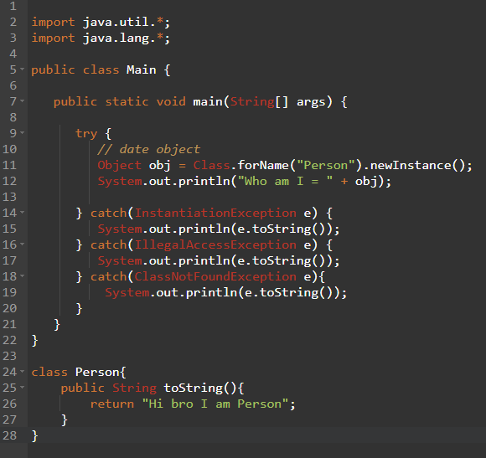
new Vs newInstance
If you only know the name of the class at run time then newInstance is used. newInstance method returns Object type hence type casting is done.
Ex:
OUTPUT
Only Problem is that Object class method can only be called.
& Class having parameterized constructor can’t be used

Slide 17
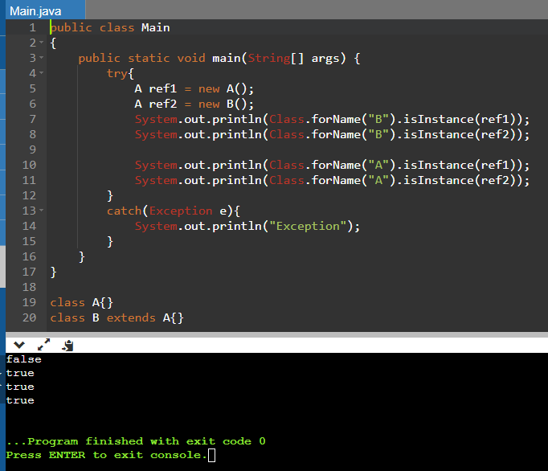
Instanceof vs isInstance
isInstance method is similar to instance of method but With just string as argument check can be done.
Try to read isInstance method from last to first to think similar to instance of method.

Slide 18
FLOW CONTROL
Ex 1:- boolean b = false;
if(b=true){SOP(“HI”);} -> o/p HI
Ex 2:- boolean b = true;
switch(b){…} -> long, boolean, float, double can’t be used in switch.
In case (of switch) only final variables can be used because if non final variables were allowed then duplicate case label might happen.
Ex : final int x =20;
switch(x){
case x: SOP(“HI”);
} -> o/p HI
Duplicate case label will give compile time error
Ex : switch(9){
case ‘a’ : sop(“HI”);break;
case 9 : sop(“HELLO”);break;
case 97 : sop(“WELCOME”);break;
}
CE : duplicate case label

Slide 19
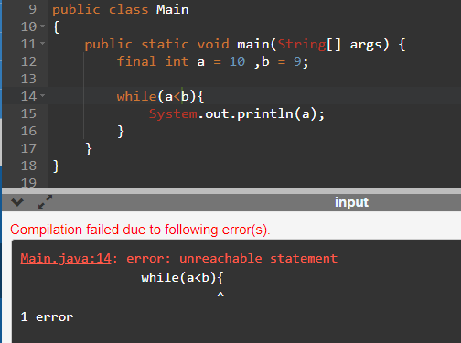
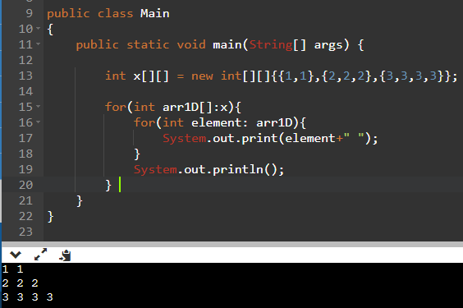
If used a>b or a==b for the image on right then it will be
an infinite loop printing 10.
Apart from for loop to retrieve all elements of arrays
or collections for each loop can be used.
Ex :->

Slide 20
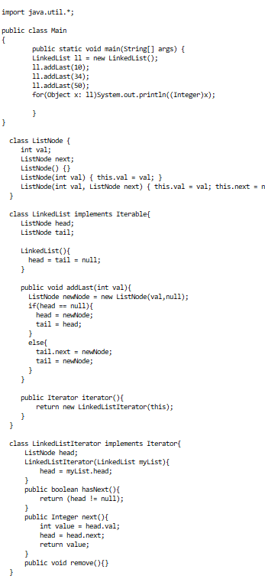
ITERATOR & ITERABLE
Iterable {present in java.lang package} is an interface having one method called iterator(){present in java.util package} which returns Iterator type object(even Iterator is an interface).
The target element in for each loop should be Iterable type. (i.e. for(element in:target))
An object is said to be Iterable if and only if corresponding class implements Iterable.
All array related classes & collection implemented classes implement iterable interface.
Iterator has three unimplemented methods hasNext(), next() & remove().
To implement for each functionality the class should implement iterable and return iterator object.
To return iterator object create another class that implements iterator and override hasNext(),next() & remove() methods.

Slide 21
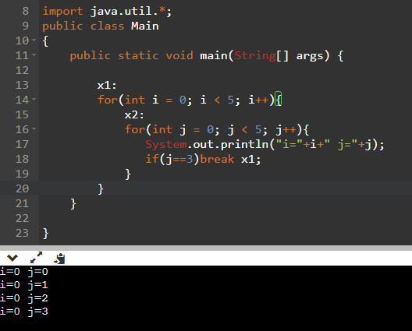
LABEL
As already used in right image. Label helps in breaking out of outer loops as well from an inner loop. This can be used instead of goto.
Similarly labelled continue can also be used.
goto is no longer used in java because it’s makes difficult to track the flow of program & makes the program hard to modify.
const is also no longer used in java as we could even use final instead of const.
One more reason is for most part because JDK doesn’t need it, ‘const’ has not implementation in java.

Slide 22
Public class
If class A is public then it should be saved as A.java.
If class is not public then it can be saved as (anyName).java.
Only one public class for a given .java file but there can be many non public class for given .java file.
Only public & default can be used as modifiers to class in java.

Slide 23
IMPLICIT & EXPLICIT IMPORT
Implicit ex -> import java.util.*;
Explicit ex -> import java.util.Scanner;
Note : 1) Explicit import has higher priority than implicit import if say java.util.* & java.sql.Date is used then Date of sql will be considered if we declare it.(even though util package also has date class in it.
2) All the classes within java & java.lang package are already available for the programmer by default. (Ex. String is present in java.lang package)
3) import basically loads only the required .class file run time. Hence it is called dynamic include or load on demand or load on fly.

Slide 24
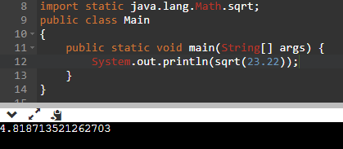
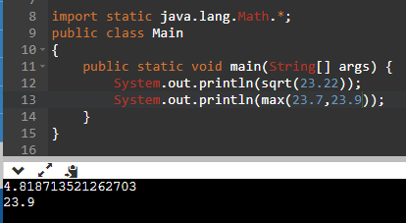
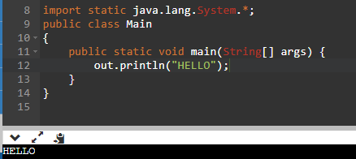
STATIC IMPORT
Basically imports static methods/variables of a class directly and makes the code look smaller.
Ex :
In ex 1 only sqrt (static)method of Math class is used directly.[explicit]
In ex 2 all static methods/varaibles of Math class are imported & used.[implicit]
In ex 3 all static methods/static variables of System class is imported & only out variable is used.[implicit]
System -> class name
out -> static ref variable ( which holds PrintStream object)
println() -> intstance method present in PrintStream object

Slide 25
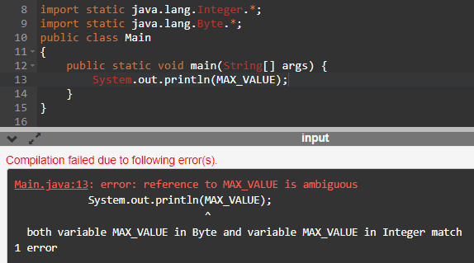
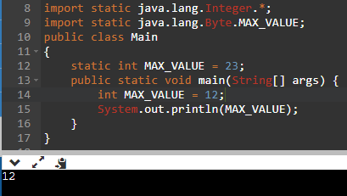
DISADVANTAGES OF STATIC IMPORT
Since chances of static methods/variables having same names are more when compared to classes there is more ambiguity problems in static methods/variables.
Hence if there is not need of using static import don’t use it.
Ex :
Ex2 :
Here priority order will be (as per ex2)
local variable>static class variable/method>explicit static method/variable > implicit static method/variable

Slide 26
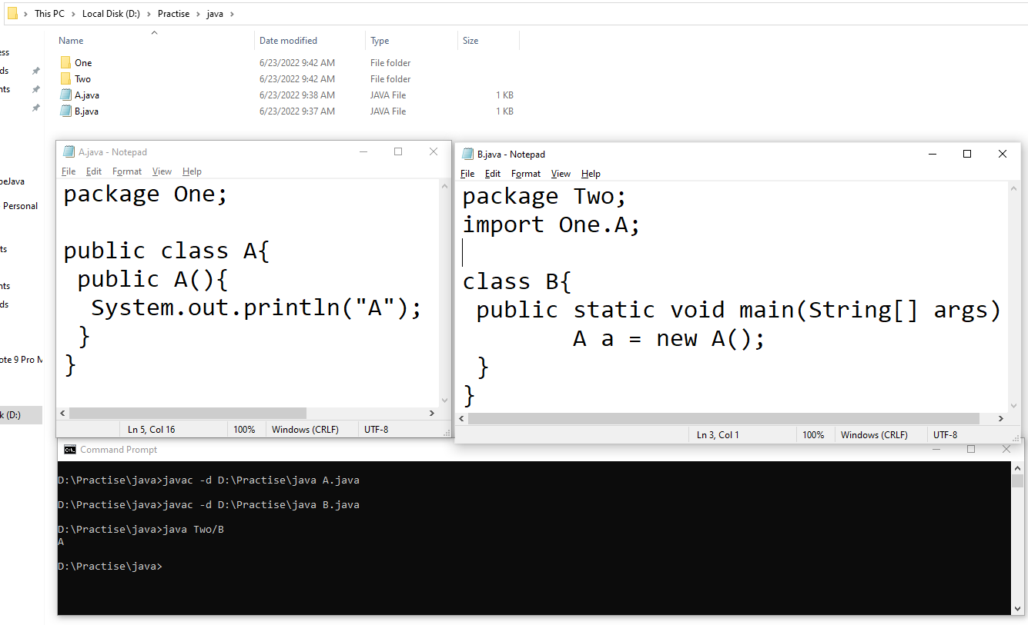
Package
Package must be the first line in the program (should be written before import).
Here –d path basically tells the compiler that the .class file has to be created within the package mentioned in the program (even . Can be used instead of path)
After line1 i.e. javac –d path A.java A.class file is generated within One.
After line2 i.e. javac –d path B.java B.class file is generated within Two.
Finally to execute B.class java Two/B is used. Hence output “A” is visible on the screen.
Note -> Both class & constructor is public hence it worked. Else you wil get error.

Slide 27
abstract
Except public & protected & default all the other modifiers can’t form combination with abstract in method level.
Abstract class ->
If atleast one method is abstract then class should be abstract.
It is not compulsory to have abstract methods in an abstract class. Ex: Adaptor class has no methods but still it’s abstract.
Abstract class can contain final method but final class can’t contain abstract method.

Slide 28
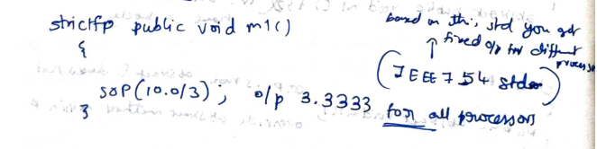
strictfp
Java is platform independent language, so to get platform independent result for floating point arithmetic we use strictfp modifier.
Abstract method says not to implementation but strictfp wants implementation hence for methods abstract & strictfp is illegal combination.
But for class level abstract & strictfp are legal combination.
Because if a class is declared as abstract & strictfp then
Every floating point operation(in non abstract method)
being performed will follow IEE754 standard by default so
that we get platform independent result.

Slide 29
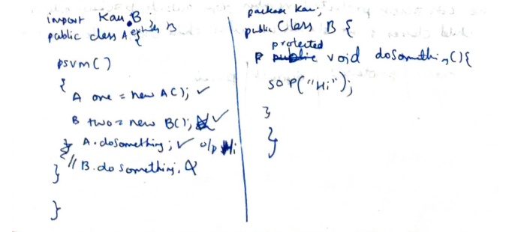
Protected modifier
Protected methods of parent class can be accessed within the same package or from other package only by child class method.
Still in child class also we cannot create parent object… we can only access parent class method.
Ex: -
Note: while overriding a method say protected, it can be provided higher access(like public,protected access can be given) but not lower(like <default> can’t be given).Because of problem when Parent ref & child Object.

Slide 30
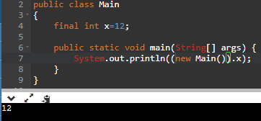
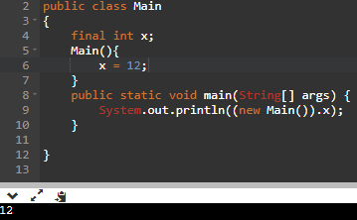
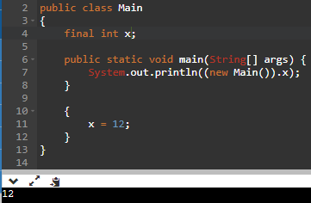
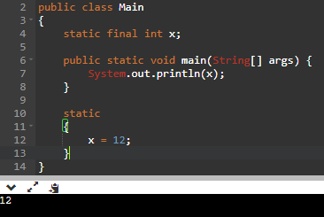
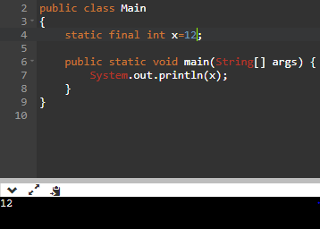
Initializing final variable
Final instance variables can be initialized either within the constructor or within the instance block or during the declaration.
Final static variables can be initialized either within static block or during the declaration.
Only modifier used for local variables is final.
Note: if local variables are not initialized it won’t give error until you try to print them.

Slide 31
static
A class cannot have instance & static method with same method signature(i.e. same name and same parameters).
And static methods cannot be made abstract… The implementation must be provided.
static abstract cannot be used because it cannot be overriden by the child class.
synchronized
Applicable for methods/blocks, but not for classes & variables.
If multiple threads try to operate simultaneously on same method (static/instance) then there might be data inconsistency problem. This is called race condition. Hence to avoid this synchronized is used.
Synchronized method/block must contain implementation hence synchronized & abstract cannot form a combination.
Static synchronized is a valid combination.

Slide 32
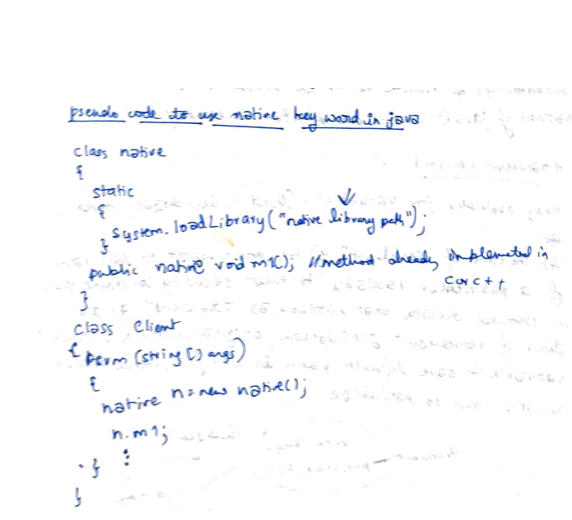
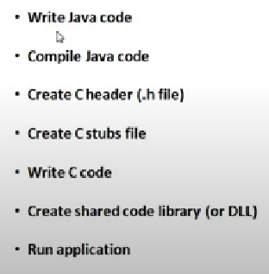
native
Used to use already existing method(which might be platform independent) implementation (present in c/c++ ) in current java program.
Use -> to improve performance & achieve machine level communication & also use already existing non java code.
Disadvantage -> Platform independent nature of java will go.
For it to work below steps have to be followed.
native & strictfp is illegal combination coz native method might have used other std to perform floating point operation.
native & static is possible combination.

Slide 33
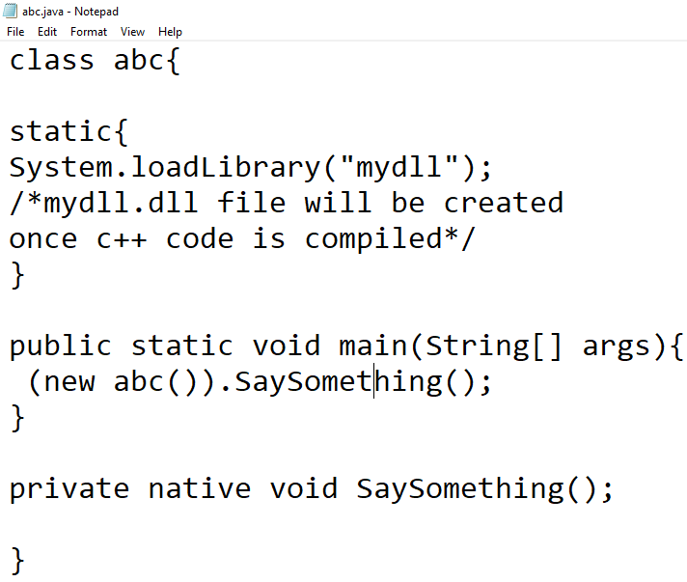
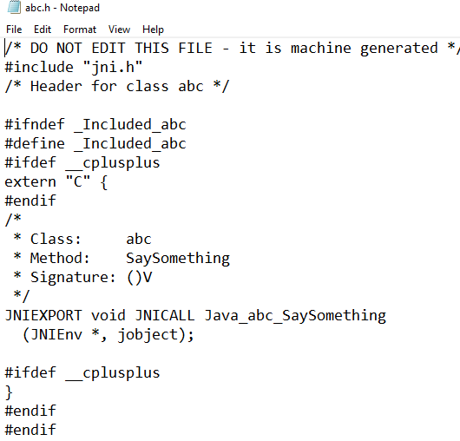
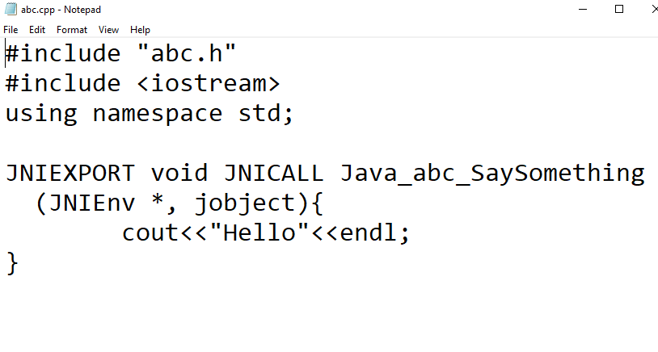
Steps
Generated by compiler completely in pwd
javac abc.java –h .
Created abc.java file
Implemented SaySomething()
method by me
In abc.cpp file
Execute abc.class file
java abc
o/p Hello
Compiling abc.cpp to get mydll.dll file
(can give any name to .dll file but already mentioned mydll in abc.java file)
g++ -c -I "C:\Program Files\Java\jdk1.6.0_21\include" -I "C:\Program Files\Java\jdk1.6.0_21\include\win32" abc.cpp -o abc.o
g++ -shared -o mydll.dll abc.o

Slide 34
Initially when abc.java file is compiled using (javac abc.java –h .) that time 2 files will be created in pwd 1)abc.class & 2)abc.h
Using abc.h file abc.cpp file is written to implement that unimplemented native function/method.
While compiling abc.cpp file don’t forget to write main method.
g++ -c -I "C:\Program Files\Java\jdk1.6.0_21\include" -I "C:\Program Files\Java\jdk1.6.0_21\include\win32" abc.cpp -o abc.o
The above command compiles abc.cpp and creates abc.o … The reason why include & win32 path is provided is because jni.h & jni_md.h files that are necessary are present in those include & win32 folder.
g++ -shared -o mydll.dll abc.o
The above command basically uses abc.o file to get mydll.dll file(any name you can give for the .dll file)

Slide 35
transient
Applicable only for variables.
Transient can’t be used with static.
At the time of serialization if the value of variable (suppose password) shouldn’t be saved then JVM ignores the original value and saves the default value to the file.
volatile
Applicable only for variables.
When multiple threads try to keep changing the value of a variable. To avoid data inconsistency problem volatile is used wherein each thread will be working on the variable in the main memory not cached one.
Advantage -> Overcome data inconsistency problem.
Disadvantage -> Creating & maintaining separate copy for every thread is costly operation.

Slide 36
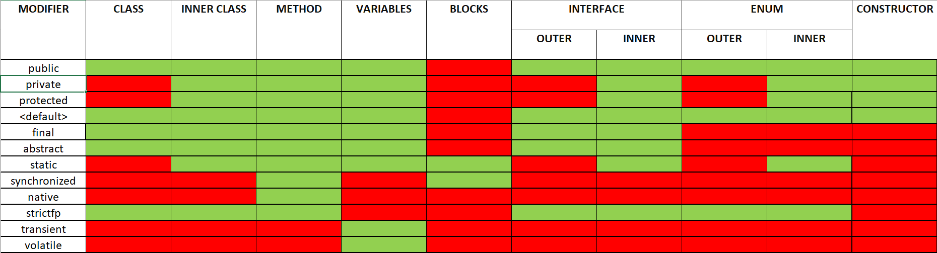

Slide 37
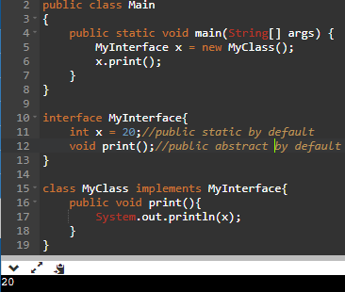
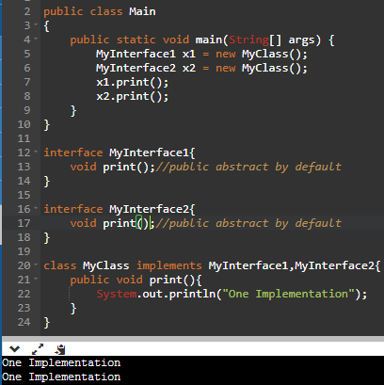
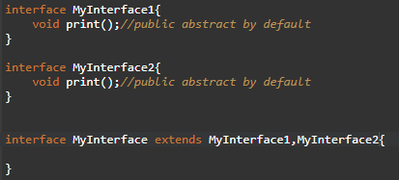
interface
Contains abstract methods & static constants.
Interface supports multiple inheritance because there is no ambiguity problem like in classes as only one implementation will be provided by the implementation class.
Even interface can extends multiple interfaces.

Slide 38
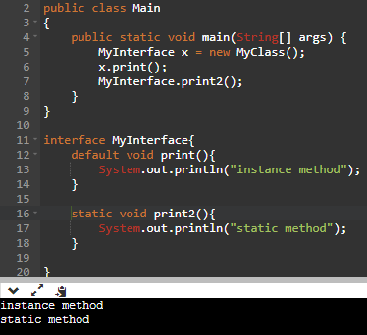
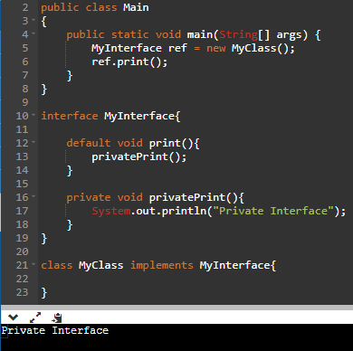
Since java 8 we can have default and static methods in an interface.
But modifier public can only be used for both default & static methods (in java 8).
Variables in interface is always static final.
Since java 9 we can have private methods(even static private is possible) in an interface.

Slide 39
interface in summary
Variables can only be public static.
Abstract methods can only be public.
Default methods & static methods also can only be public.
Only other modifier used is private.
If same default method in 2 interface is implemented simultaneously by a class then we get error.
If static method in interface is implemented in class then it will not be available to implementation class. We have to call those in implementation class with interface reference. But this is not applicable for abstract class & it’s implementation class.
Multiple interfaces can be implemented by a class.
Multiple interfaces can be extended by an interface.
Static blocks not allowed.
Why variable is only public static final?
Public -> because can be accessed by implementation class from anywhere.
Static->because instance variable can’t be present as there is no constructor to initialize.
Final -> because if one of the implementation class changes the value then it will be changed for all the other classes.

Slide 40
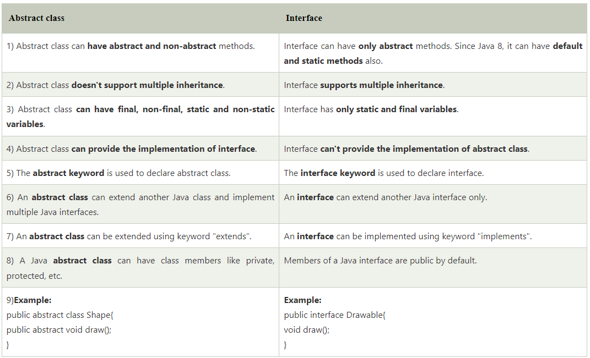
Abstract class vs interface

Slide 41
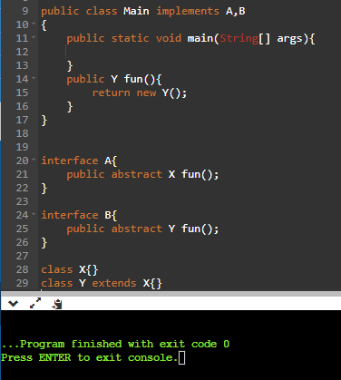
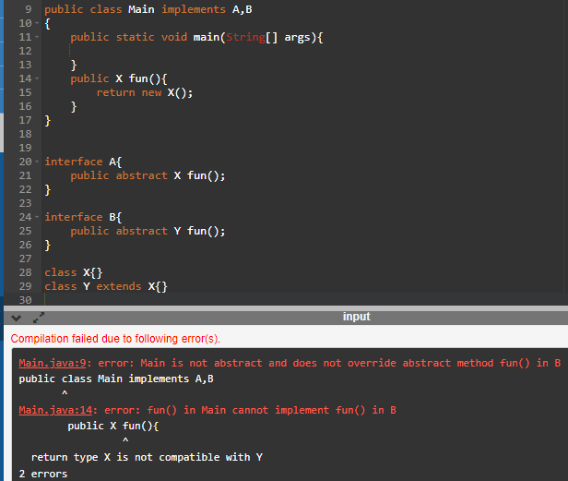
Interface examples of corner cases
If two interfaces methods have same signature & covariant return types only then implementation class can implement. Else if two interfaces have same method signature but not covariant then error.
Also for covariant return types the implementation class should return child object otherwise again error.

Slide 42
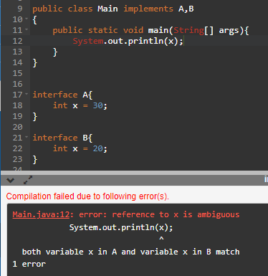
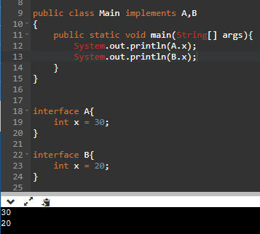
Variable naming in interface
If two interfaces have same variable name then you can’t directly call the variable name as it would result in ambiguity, instead use interface name followed by variable name.

Slide 43
Marker interface
These interfaces doesn’t have any method within them.
But by implementing these interface the Class gets specific behaviour.
Ex - > Serializable, Cloneable, RandomAccess etc.
By implementing Serializable the objects can be saved to the file & can travel across the network.
By implementing Cloneable our objects can be duplicated.
Without methods how object gets special ability? -> Internally JVM checks say is this class implementing Serializable(may be by using instanceof operator). If yes then JVM itself provides that ability.
Why JVM provides these ability? -> To reduce the complexity of programming
We can create our own marker interface but customization by JVM is required.
Advantage of interface over abstract class
Multiple inheritance is supported in interface.
While extending abstract class we can’t extend other class but for interface even if we implement multiple interfaces still extend can be done for other class.
Interface itself can extend multiple interfaces but abstract class can’t

Slide 44
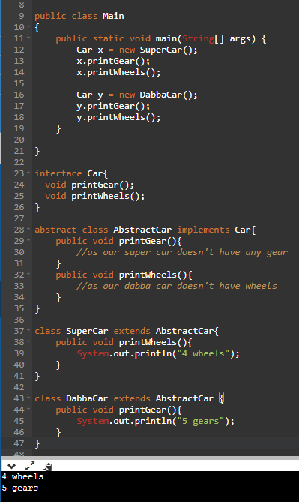
Adopter class
Adopter class is an abstract class that provides dummy implementation of few or more methods.
Here AbstractCar class is adopter class as it provides dummy implementation for printGear & printWheels method.
Because printGear method can’t be called for our SuperCar.
llly printWheels method can’t be called for DabbaCar as our DabbaCar doesn’t have wheels.
Why adopter class is abstract? Because if you create object then non of the methods provide implementation so.

Slide 45
OOPS
1)Data hiding -> using private methods
2)Abstraction -> using interfaces and abstract class
3)Encapsulation -> binding data members & methods together into single unit. If all the data members within the class is private then it is called tightly encapsulated class. And if parent is not tightly encapsulated then child can’t be tightly encapsulated.
Ex: packages, classes etc.
4)is a relation -> Also called inheritance. Advantage is code reusability. Achieved using extends keyword. Ex-> Person -> Student -> Topper => Topper is a student & a Person, Student is a Person.
5)has a relation -> Also called composition(strong association) or aggregation(weak association).
Note:
Parent ref can be used to call child object but it can only call parent specific methods.
If our class doesn’t extend any other class then it is direct child class of Object class. But if our class extends some other class then our class is indirect child class of Object class.
A class can’t extend itself. llly cyclic inheritance is not possible(i.e. if X & Y are two classes then X extends Y and Y also extends X is not possible).

Slide 46
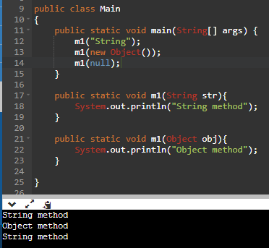
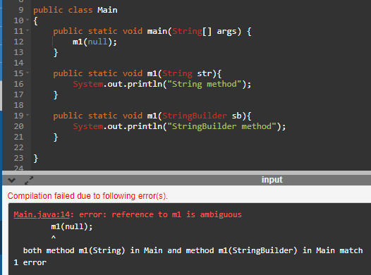
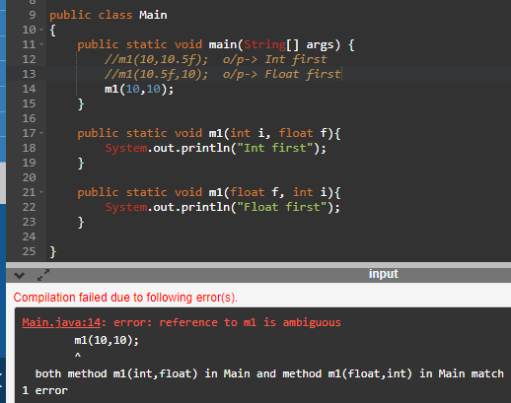
Overloading
When two or more methods have same name but different argument/s then it is said to be overloaded.
CASES:

Slide 47
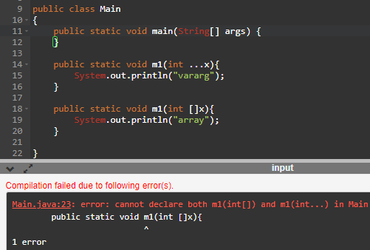
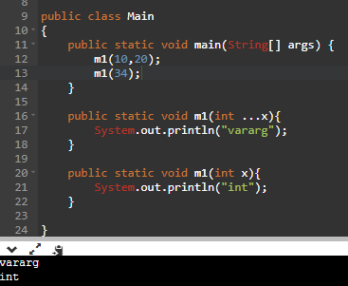
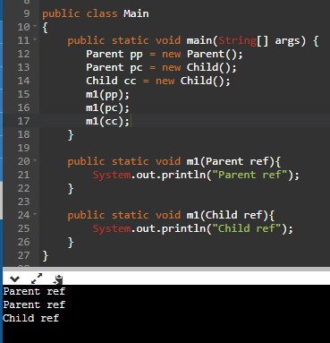
It is clear from last example that overloading is compile time dependent.

Slide 48
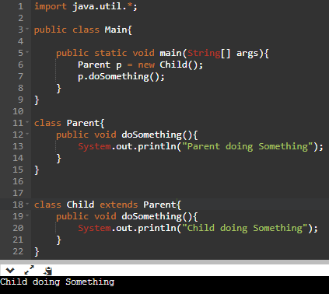
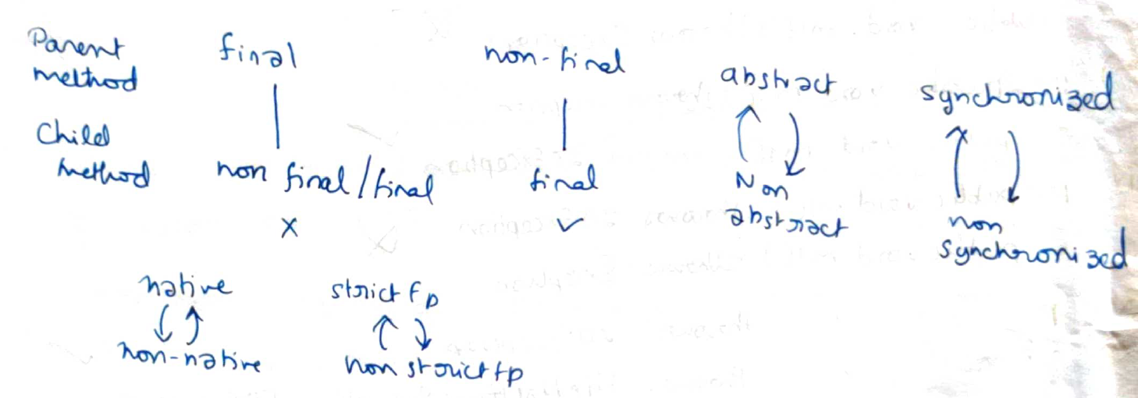
Overriding
In overriding method resolution is always taken care by JVM based on run time object. Hence overriding is also considered as run time polymorphism or dynamic polymorphism or late binding.

Slide 49
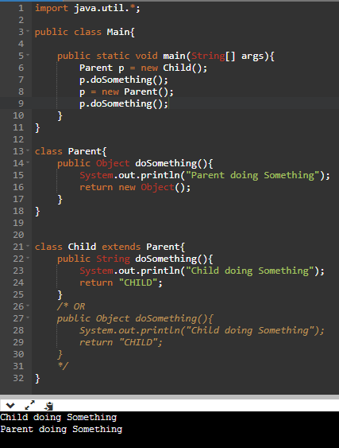
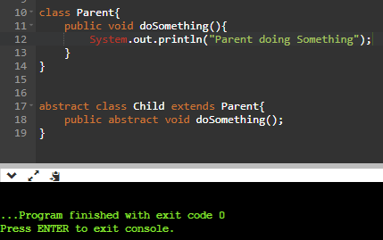
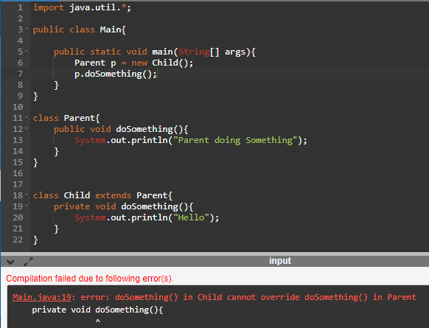
Conditions
Method signature should be same.(name,argument)
Covariant return types are valid. i.e. child overridden method can return Parent type or it’s child type.Having same signature in parent & child private method doesn’t mean overriding but still is valid.
Final methods can’t be overridden.
Parent class abstract method is overridden in child class to provide implementation.
Implementation of Parent method can be prevented in child as shown.
While overriding child should have either equal or more access than parent.(Because Parent ex in right)
Ex: Parent method -> protected then child method -> protected,public but not private.

Slide 50
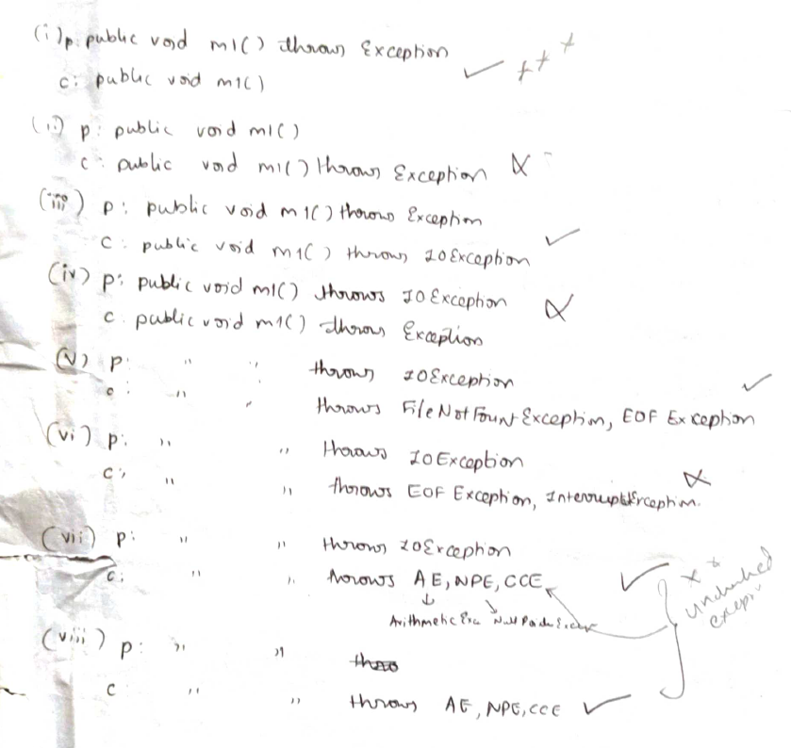
If parent/child throws exception
If child class throws any checked Exception then parent class must throw either same check Exception or It’s parent Exception.
If child class throws unchecked Exception(like NPE,AE,CCE etc.) then parent class need not throw any exception.

Slide 51
Static method overriding
Static & instance method overriding not possible.
But static & static method overriding is called method hiding. Here at compile time itself which method will be called is known.
Method hiding vs Method overriding
Only applicable for static methods.
Compiler decides.
Is an ex for compile time polymorphism or early binding or static polymorphism.
Only applicable for instance methods.
JVM decides.
Is an ex for run time polymorphism or late binding or dynamic polymorphism.

Slide 52
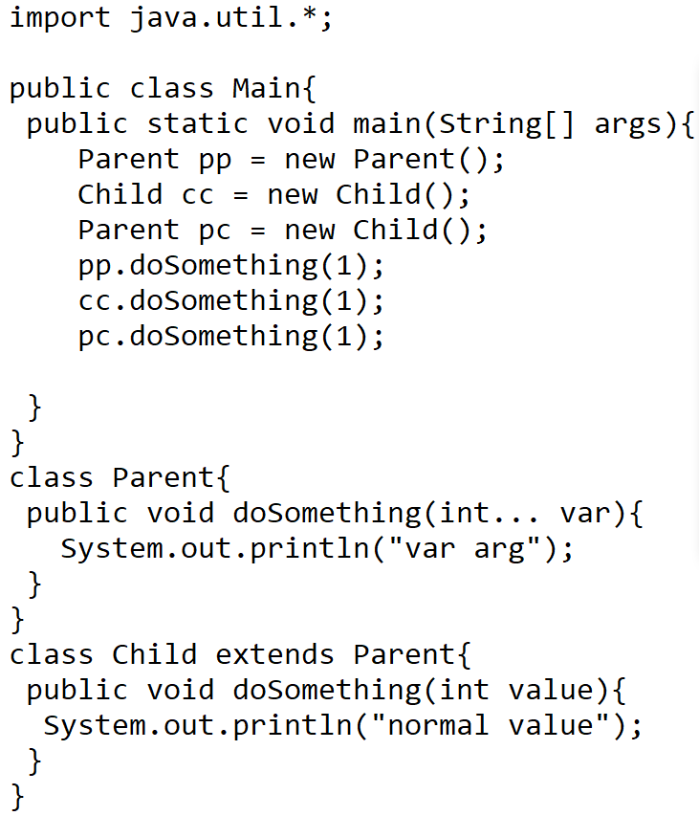
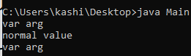


Exceptional cases
Overriding of varargs happens only when both
Methods are varargs. This is somewhat overloading .
Overriding is not applicable for variables.

Slide 53


By typecasting we are trying to assign new Reference to already existing object.

Slide 54
Cohesion & coupling
Cohesion of a class(or a module) is said to be strong if the functions involved in perfoming a certain task are together.
Ex: In Node class(RubiksCube) to perform getCount(i,j,k,dim) methods like isIndexValid(i,j,k,dim) , isCornerNode(i,j,k,dim), isEdgeNode(i,j,k,dim) & isCenterNode(i,j,k,dim) are together involved strongly. Hence this is an example for cohesion.
Coupling of many classes(or modules) is said to be loose if all the classes are less dependent on other classes.
Ex: SolveCube class basically is performed with the help of PlusBottom, LayerFirst, LayerSecond, PlusTop, Corner & LayerThird.
Here all the classes PlusBottom,LayerFirst … etc. are less dependent on each other hence it is loosely coupled.
NOTE : Best practice would be to have strong cohesion & loose coupling.

Slide 55
Static control flow
Direct read -> If we directly read the value of variable without the use of method.
Indirect read -> If we use method to read the value of variable indirectly.
In static flow following things will happen-
Static variables, static blocks, static methods are identified from top to bottom. In this stage variables are said to be in read indirectly write only state (RIWO) i.e. you can read the variable only with the help of method but not directly.
Execution of static variables and static blocks.(After execution static variables can be read directly i.e R&W).
Execution of main method.
Static blocks are executed at the time of class loading.
Static control flow is one time activity which happens once during class loading. Whereas instance control flow will be performed for every object creation.
If parent & child are present then static flow is as follows-
Identification of static variable, static block from parent to child.
Execution of static variable, static block from parent to child.
Execution of child main method.

Slide 56



Slide 57
Instance control flow
In instance control flow if parent, child are present then following things happen
Identification of instance variable, instance block and instance method.
Execution of instance variable assignments and instance block.
Execution of constructor.
In instance control flow if parent, child are present then following things happen
Identification of instance variable, instance block and instance method from parent to child.
Execution of instance variable assignments and instance block of parent class.
Execution of parent constructor.
Execution of instance variable assignments and instance blocks in child class.
Execution of child constructor.
RIWO , R&W are applicable for instance control flow as well.

Slide 58



Slide 59
Constructor
You can have methods with same name as name of the class you won’t get any error. But it is not recommended.
If there is no constructor in a class then Compiler creates a default constructor as follows -> ConstructorName(){super();}
If there is a constructor either with arg or without arg then compiler won’t create any default constructor.
First line of every constructor should be super() or super(arg) or this() or this(arg). If not then compiler will add super().
super() or this() can be only used within the constructor only once and that too in the first line only. Both super() & this() cannot coexist in the code.
If first line of constructor is this() or this(arg) in the back super() will be called. If super() or super(arg) is mentioned in the constructor then in the back again super() won’t be called.
For constructor only overloading is applicable.
If Parent class contains arg constructor then Child must contain arg constructor else error.
If Parent throws any checked Exception then Child should throw same or it’s parent Exception type. Because of child calling parent using super() is mandatory.
Constructor can be public , private or protected.

Slide 60
Design pattern
Creational design pattern (For creating classes)
Factory
Abstract factory
Singleton
Structural design pattern(combining these classes to form a structure perform specific task)
Bridge
Adaptive
Composite
Behavioural design pattern(how classes behave i.e links between classes)
Interpreter
Strategy
Observer

Slide 61


Factory Design pattern
If Vehicle is an interface and Car,Bike class implements Vehicle then in main if we create Object then for every new class being added say Auto,Truck etc in the main method extra if else must be added. Hence to avoid it factory class deals with it.

Slide 62
in
V

Slide 63
in
V

Slide 64
in
V

Slide 65


EXCEPTION
For every thread JVM will create run time stack.
Each and every method call performed by thread will be stored in corresponding stack.
Each entry in stack is called stack frame or activation record.
After completing every method call corresponding entries will be removed. And after all removals of method call JVM will destroy the stack.
Throwable class has following essential methods
String getMessage() -> returns Exception description
String printStackTrace() -> prints the stacktrace
String getCause() -> returns the cause for Exception
String toString() -> returns Exception name + description
Constructors
Throwable()
Throwable(String message)
Throwable(String message, Throwable cause)
Throwable(Throwable cause)

Slide 66

Example & Throwable
When exception occurs then complete call stack will be printed (from where the exception occurred) if none of the methods which called it doesn’t handle the exception.
Throwable class has two child classes
Exception
Error
Exception & Error can be handled by try catch block but error can’t be recovered. i.e. if out of memory error occurs then you won’t get additional memory. Similarly if stack overflow error occurs then stack size won’t be recovered.

Slide 67


Slide 68
Checked VS Unchecked
Exceptions which are checked by the compiler for smooth Execution of program are called checked exception
Exceptions which are not checked by the compiler are called unchecked exception.
If Exceptions are checked then we have to handle them either using try catch or using throws keyword. If not we will get Compile time error.
Runtime Exception & it’s child along with Error come under unchecked category.
Note: Whatever is the type of exception checked or unchecked it will occur only at run time. And default Exception handler will use printStackTrace method to print exception.
An exception is said to be fully checked if itself & all it’s child exceptions are checked.
Ex: IOException, Interrupted IO Exception.
An exception is said to be partially checked if it or it’s child have combination of both checked & unchecked.
Ex: Exception, Throwable (only possible examples)

Slide 69


Try catch
Code which has exception chance is put in try block & when exception occurs it will be caught in the catch block.
If multiple catch blocks are present then child Exception must be first caught then the parent Exception otherwise you will get Compile time error saying Exception XXX has already been caught.
Multiple catch blocks with same Exception being caught also results in compile time error.
finally block which is written after catch block will always be executed irrespective of whether the exception is raised or not /handled or not.
Basically finally block performs clean up task. i.e. which ever resources have been opened within try block will be closed inside finally block.
Try+finally is also a valid combination.
Whenever we throw new Exception()… we are basically handing over the Exception object to JVM.
Note: throw works only for Throwable type objects and
Not applicable for normal java objects.

Slide 70
Specialty of throws
It delegates the responsibility of exception handling to caller. Then caller is responsible to handle the exception.
It is required only for checked Exception & usage of throws for unchecked Exception doesn’t make any sense(Even you can do it but it’s of no use).
Throws keyword is only used to convince the compiler & usage of throws keyword doesn’t prevent abnormal termination of program. i.e. at runtime exception will rise if it has to.
Throws cannot be used for class, it can only be used for methods both static & non static.

Slide 71


Customized Exception
Note:
Throws keyword is most suitable for user defined exception but not for predefined exception.
It is a good practice to extend customized exception with Checked exception type.
For example : instead of extending either Throwable or Exception (which are partially checked) or Error(which is unchecked) preferably use fully checked exception while extending.

Slide 72
Top 10 Exceptions
Exceptions can be of 2 types -> 1) JVM created 2)Programmer created Exception.
1)ArrayIndexOutOfBounds Exception
Unchecked
Child of Runtime Exception
Raised By JVM if trying to access array elements of invalid index.
2) NullPointer Exception
Unchecked
Child of Runtime Exception
Raised By JVM whenever we try to perform operation on null.
3)ClassCast Exception
Unchecked
Child of Runtime Exception
Raised By JVM if typecasting of Parent to child couldn’t be performed.
Exception
Runtime Exception(unchecked)
Arithmetic Exception
NullPointer Exception
Class Cast Exception
IllegalArgumentException
NumberFormatException
IllegalThreadStateException
IndexOutOfBoundsException
ArrayIndexOutOfBounds Exception
StringIndexOutOfBounds Exception
IO Exception(fully checked)
FileNotfound Exception
EndOfFile Exception
Interrupted IO Exception
Servlet Exception (fully checked) & so on.
Interrupted Exception (fully checked)
Error(unchecked)
Assertion Error
VM Error
Stackoverflow Error
Out of memory error

Slide 73
4) StackOverflow Error
Unchecked
Child of VM Error which is child of Error class.
Raised By JVM stack becomes full(mostly during recursive calls).
5) NoClassDefFound Error
Unchecked
Child of Linkage Error which is child of Error
Raised By JVM whenever JVM is not able to load the required .class file.
6) ExceptionInInitializer Error
Unchecked
Child of Linkage Error which is child of Error
Raised By JVM if Any error or exception happens during static variable assignments & static block execution.

Slide 74
7) IllegalArgument Exception
Unchecked
Child of Runtime Exception which is child of Exception class.
Raised By PROGRAMMER to indicate that method is invoked with illegal argument.(Ex: if argument can be between 0-10 then if tried giving 11 as argument this exception can be thrown)
8) NumberFormat Exception
Unchecked
Child of IllegalArgument Exception which is child of Runtime Exception class.
Raised By PROGRAMMER to indicate that the number format given is wront.(Ex: Integer.parseInt(“10”) is valid but Integer.parseInt(“Ten”) is invalid so this exception is thrown.)
9) IllegalThreadStateException
Unchecked
Child of Runtime Exception which is child of Exception.
Raised By PROGRAMMER to indicate that the operation currently performed will result in illegal state(Ex: Thread t = new Thread(); t.start(); t.start();->RE:IllegalThreadStateException)
10) Assertion Error
Unchecked
Child of Error
Raised By PROGRAMMER to indicate that assert statement failed. (Ex: try{assert(10<0);}catch(AssertionError e){System.out.println(“10 is > 0”);}

Slide 75


Try with autoclosable option
If the resources that are opened implement Autoclosable interface then it can be automatically closed without using finally block also even if Exception arises or not.
We can declare multiple resources separated by semicolon But resource references would be final i.e you can’t re-assign other Objects to resource reference again.
FileReader & FileWriter both implement Autoclosable interface so it works fine.

Slide 76


Autocloseable interface
Autocloseable interface have one method close which closes all the resources that are opened.
We can create our own class which is Autocloseable. Check the below ex.
Resources are automatically closed
Resources are automatically not closed

Slide 77


Catch block with options
Note the options given with brackets cannot have any parent child relation.

Slide 78
Inner class
Relation between outer and inner class is has a relation.
If outer class cannot exist without inner class then inner class is preferred. Ex : Linked list & interface Map{ interface Entry{} }
Inner class can’t have static fields & hence can’t have main method.
We can’t call inner class directly from outer class.
Think inner class as a variable that has attribute+properties.
Types of inner classes
(1) Normal or regular inner classes
(2) Method local inner classes
(3) Anonymous inner classes
(4) Static nested inner classes.

Slide 79


1)Normal or regular inner class
If we declare named class inside a class without making it static then such type of inner class is called normal or regular inner class.
Ex: class Outer{ class Inner{} psvmain(str args[]){}}
Here if we compile Outer.java then we get two .class files 1)Outer.class 2)Outer$Inner.class
Inner class methods are instance methods. So if we have to access them from static method then we have to first create outerclass object & then call the new Innerclass object using the outer class as shown.(Same for accessing from outside of the class as well as shown).
If we have to access inner class method from instance methods then it is easier to do it by directly creating innerclass type object.

Slide 80

By default instance members of outer class are available to the inner class.
And to use this keyword within inner class we have to do OuterClassName.this
Nesting of inner class is also possible. i.e. class within inner class.
Similarly as outer class can have following modifiers
public
default
abstract
strictfp
final
Inner Class can have above modifiers & also private, protected, static.

Slide 81

2)Method local inner class(MLIC)
Class declared within a method(either static or instace) is MLIC.
MLIC within static method -> only outer class static members are directly available
MLIC within instance method -> both static & instance members of outer class is directly available
The scope of method local inner class is only within a method.
MLIC also has access to local variables of the outer class method(where MLIC is defined).

Slide 82



3) Anonymous Inner class
Some times we can declare inner class without name. Hence the name anonymous.
Types of anonymous inner class
Anonymous inner class that extends an class. Example is shown in the right.
Anonymous inner class that implements an interface. Example is shown below.
Anonymous inner class that is defined within arguments. Example of Comparator interface shown below to right.
Disadvantage -> can implement/extend only one interface or class at a time And can’t have constructor as anonymous inner class doesn’t have name.

Slide 83


4)Static nested class
Inner classes defined with static keyword are called static nested inner class.
In case of normal inner class without existence of outer class object there was no chance of existence of inner class object. But that is not true in case of static nested class. Here even without the existence of outer class object inner class object can exist.
Here static inner classes can even have static members including main method. (command to run main method -> java Outer$Inner
But one thing that static nested class doesn’t possess is access to Outer class instance variable. But it has access to Outer class static variables.

Slide 84



Class-interface combo
We can create class inside interface but the class will be by default static.
We can create interface inside interface as well.
We can create interface within a class as well.

Slide 85


Imp Note : Since Inner interface within Outer interface is always static inner interface implementation can be provided separately.
All classes, interfaces within interface is public static always.
We can provide default implementation of an interface using inner class concept.
Interface define within class is always static. ***

Slide 86
in
V

Slide 87
in
V

Slide 88
in
V

Slide 89
ArrayList(C) & Vector implements S,C,RA
LinkedList(C) & ArrayDeque implement S,C
PriorityQueue implements S
S->Serializable(I), C->Cloneable(I), RA->RandomAccess
Iterable(I)
Collection(I)
AbstractCollection(AC)
Queue(I)
AbstractCollection(AC)
List(I)
AbstractQueue(AC)
AbstractList(AC)
Dequeue(I)
PriorityQueue(C)
LinkedList(C)
ArrayDeque(C)
ArrayList(C)
Map(I)
Vector(C)
Stack(C)
HashMap(C)
AbstractMap(AC)
LinkedHashMap(C)
TreeMap(I)
AbstractSequentialList(AC)

Slide 90


Collection interface

Slide 91
Random Access
It is a marker interface and arraylist implements it.
Basically it conveys that the elements within array list can access elements in O(1) time. But linked list doesn’t extend random access.
Ex: Suppose we are given a list and we don’t know whether it is a linkedlist or arraylist or stack or so on… But what we want to do is access the element only if it’s access time is O(1) then in such case we can check if our class is instanceof random access or not.

Slide 92
Collection methods
Boolean add(E e) -> Adds e to current collection
Boolean addAll(Collection c) -> Adds all the elements in c to current collection
Boolean remove(Object element) -> removes element from current collection.
Boolean removeAll(Collection c) -> removes all the elements in c to current collection
Int size() -> returns size of current collection
Void clear() -> clears all the elements within current collection
Boolean contains(Object element) -> returns true if element is present in collection
Boolean containsAll(Collection c) -> returns true if collection elements are present in current collection
isEmpty() -> returns true if the Collection is empty.
Iterator iterator() -> returns Iterator that helps to iterate through the collection

Slide 93
List
add(int index,E element) -> add element at particular index & if not possible throws error
addAll(List l) -> adds all the elements of list l to current list.
get(int index) -> returns element at given index & if not possible throws error
set(int index, E element) -> sets value at given index to element & if not possible throws error
remove(int index) -> removes the element at given index & returns(if invalid index then error)
indexOf(Element e) -> returns the index of first occurrence of the element if exist else returns -1
toArray(T []a) -> puts the element of list to a[] in order
sort(Comparator c) -> Sorts the given list according to Comparator c(see next page for implementation of this);
ListIterator listIterator() -> ListIterator extends Iterator interface & has one extra method has Previous & previous method which allows to iterate over the list in back word direction as well. But it’s only application for List.
NOTE : Incase index is –ve or (is +ve but out of range) then indexoutofbounds exception will come

Slide 94

Array List
Note : Size change when new element is added = n -> n+(n/2)+1 i.e if initially size,n = 10 then it becomes 16.(50% increase in capacity)
Constructor -> ArrayList(int initialCapacity) ensures initial size of n
Array List VS Vector
Arraylist is not synchronized but vector is.
Capacity of Arraylist increases 50% everytime whereas in vector it is 100%.
Vector is a legacy class.
ArrayList is fast because it is not synchronized.
Use of sort method in list

Slide 95
Stack
Note : Size change when new element is added is 100%. If n is initial size then it becomes 2n(similar to vector).
Not preferable because of following reason
List implementation which means you can even get element at any index in between which shouldn’t happen in stack.
Every time capacity is filled size of stack doubles and copying will take extra overhead.
Deque Interface gives better option of multiple inheritance i.e. implementation of Linked list could also be used. But in stack as it is a concrete class it doesn’t support multiple inheritance feature.
Hence in main documentation of stack also it is saying prefer Deque over stack.
void push(Element e) -> pushes element into the stack.
E pop() -> pops top element and also returns it if stack is not empty else throws exception
E peek() ->returns top element if exists else throws exception
boolean isEmpty() -> returns true if stack is empty else returns false
int search(Element e) -> returns -1 if element doesn’t exist else returns number of elements to be popped to pop the Element e.

Slide 96
Queue(Interface)
add(E element) -> add element & throws Exception if add is not performed
offer(E element) -> add element & returns false if offer is not performed
element() ->returns the head of queue & throws exception if the queue is empty
peek() -> returns the head of queue & returns null if the queue is empty
remove() -> returns and removes head of queue & throws exception if queue is empty.
poll()-> removes and returns the head & returns null if queue is empty
isEmpty() -> returns true if the queue is empty

Slide 97
LinkedList
addLast(E element)-> adds element to the last else throws error
addFirst(E element) -> adds element to the first else throws error
getFirst() -> returns first element of the linkedlist & if not possible throws error
getLast() -> returns last element of the linkedlist & if not possible throws error
removeFirst() -> removes first element of the linkedlist & returns it else throws error
removeLast() -> removes last element of the linkedlist & returns it else throws error
peekFirst() -> retrieves and doesn’t remove first element of the list return null if empty
peekLast() -> retrieves and doesn’t remove last element of the list return null if empty
pollFirst() -> retrieves and removes first element of the list return null if empty
pollLast() -> retrieves and removes last element of the list return null if empty
offerFirst() -> adds element at the first of the list
offerLast() -> adds element at the last of the list
NOTE : Incase index is –ve or (is +ve but out of range) then indexoutofbounds exception will come

Slide 98
Priority Queue
Basically by default it gives minimum number (in case of Integer) a high priority.
So while polling the elements the minimum number will be polled first (as it has high priority by default) & order won’t be maintained.
Can pass comparator to change default order in the Constructor.
ArrayDeque
offerFirst(E element) -> add element to first & returns false if offer is not performed
offerLast(E element) or offer()-> add element to last & returns false if offer is not performed
peekFirst() or peek()-> returns the head of queue & returns null if the queue is empty
peekLast() -> returns the tail of queue & returns null if the queue is empty
pollFirst() or poll()-> removes and returns the head & returns null if queue is empty
pollLast()-> removes and returns the tail & returns null if queue is empty

Slide 99
Set
Stores only unique elements.
HashSet
Stores only unique elements in random order & implements Set.
Load factor is 0.75 which means after filling 75% of HashSet a new HashSet Object will be created.
LinkedHashSet
Stores only unique elements by preserving insertion order & it is child of HashSet.
Underlying data structure is HashSet and Hash table.
TreeSet
Stores only unique elements in sorted order & implements Set.

Slide 100

Customization

Slide 101

Map
Note : Keys must be unique & if in case you try to add key value pair whose key is already present then the latest key value pair will override the previous.
put(K key, V value) -> adds key value pair into Map
containsKey(K key) -> returns true if the key is present
containsValue(V value) -> returns true if the value is present
keySet() -> returns array of keys
values() -> returns array of values
entrySet() -> returns array of Entries(i.e key,value pair)
isEmpty()
clear()
remove(K key) -> removes key value pair for given key k & returns it if exits else returns null
V get(K key) -> returns value for a given key K
V getOrDefault(K key,V defaultvalue) -> returns value for key K if present else returns defaultvalue
int size()

Slide 102
HashMap working
In the backend we have arr of initial size 16 (with loadfactor 0.75 i.e it becomes 32 size when 75% i.e 12 gets filed if initial size is 16.) which holds LL<Node> objects.
i.e class Node<K,V>{ K key;V value;int hash;Node next<K,V>;}
Let’s consider a simple example. Let’s suppose initial size of array ,n = 6. i.e from 0-5 index;
When put(key,value) is called firstly based on the type of key hashing is performed the function is called hash function & value returned by it is index of bucket number
If key = 23422 -> key%n => 23422%6 = 4 <<- index
If key = “acd” -> [ (key[0]*(x^0)) + (key[1]*(x^1)) + (key[2]*(x^2))]%n
Let x be prime no. 7=> [(97*7^0)+(99*7^1)+(100*7^2)]%6 =>2 <<- index
In java we can simply say hash function returns hashCode%n.(instead of above)
Using the above formulas what we are trying to do is map the key to a particular index in the Node array. If a Node is already present then new Node will be linked else if index points to null then Node will be inserted.
So to get the value for a given key first hash is found(i.e. key%n) then searching starts at that index. Let’s say 3 is the hash code … Now from index 3 every Node will be checked that is linked till null. Checking of hashCode is first & if matched then key will be checked using equals emthod .(Because different keys can have same hash value.)
K key;
V value;
Int hash;
Node next<K,V>

Slide 103
Since there are lot of answers with different perspective regarding the time complexity for insertion and deletion in hashmap. Let’s understand what I understood.
If size of the linked list (in a bucket) grows above 8 then linked list is converted into a balanced tree(after java 8) which improves the performance of worstcase to O(1)+logn[insertion,deletions & search].
Average case would be O(1)+log(no. of Nodes/size). Example shown in right -> if we are searching for say N7 then O(1) time to access arr[3] & log(12/6) time to access N7 in linked list of [N7,N8].
0
1
2
3
4
N1
N3
N5
N7
N9
N2
N4
N6
N8
N0

Slide 104
HashMap
Performs put,contains operation in o(1) time.
IdentityHashMap
Similar to hashmap but to identify duplicate keys == method is used whereas in hashmap .equals() method is used.
WeakHashMap
Similar to hashmap but easily eligible for garbage collector if it’s ref is not pointing to any object. Whereas hashmap dominates over garbage collector.
LinkedHashMap
Performs put,contains operation in o(1) time & order is preserved.
TreeMap
Performs put,contains operation in o(logn) time.

Slide 105
Arrays
sort(arr), sort(arr,Comparator), sort(arr,from_i,to_i+1,Comparator) -> sorts the array arr
binarySearch(arr,target) , binarySearch(arr,target,Comparator), binarySerach(arr,from_i,to_i+1,target,Comparator) -> returns index of target if exists else returns –ve value
fill(arr,int value) -> fills all the values of array arr with value
asList(arr) -> returns list of given array. Arr should not be primitive.
Collections
sort(list), sort(list,Comparator) -> sorts the given list
Swap(list,int i,int j) -> swaps elements at index i & j
fill(list,T value) -> fills all the values of list with value
min(col) -> returns min value for a given collection
max(col) -> returns max value for a given collection
frequency(col,value) -> returns number of elements in given collection equal to value

Slide 106

Use of Comparator,Comparable
Comparable interface implementation allows a given class to override compareTo method which would be the default order for that class.
But Comparator interface implementation provides dynamic way to arrange elements in a particular order as you wish.

Slide 107
Java.lang package
All classes present in java.lang package are available to our program without importing.
Object class is also present in this package. (W.K.T Object class is direct or indirect parent of any java class)
Methods present in Object class are
Public String toString()
Public native int hashCode()
Public Boolean equals(Object o)
Protected native Object clone() throws CloneNotSupportedException
Protected void finalize() throws Throwable
Public final Class getClass()
Public final void wait() throws InterruptedException
Public final native void wait(long ms) throws InterruptedException
Public final void wait(long ms, int ns) throws InterruptedException
Public native final void notify()
Public native final void notifyAll()

Slide 108

toString()
Object class toString() method returns following thing
getClass().getName()+”@”+Integer.toHexString(hashCode())
All classes will have the above return value for toString() until and unless we override it. And hence this is the method called when trying to print ref of any java object.
hashCode()
For every object a unique number is generated by JVM which is nothing but hashCode.
JVM uses hashCode to store objects into hashing data structures like hashtable,map etc.
The advantage of saving object in such data structures is searching becomes faster.
Internally hashCode() uses address of object to generate the hashCode but hashCode doesn’t represent the address of object.
Condition while overriding hashCode method is that hashCodes must be unique for every single object.

Slide 109


equals()
We can use equals() to check if two objects are equal or not. By default Object class equals method does reference(i.e if two references point to same object) comparison but we can override it as per our need.
Things to keep in mind while overriding equals method-
Meaning of equality for your class.
If different objects are passed then ClasscastException shouldn’t be raised rather false to be returned.
Similarly if null is passed that case also should be handled properly.
Note : StringBuffer & StringBuilder doesn’t override .equals() hence even if two objects have same content it will return false. So to avoid this we have to convert them to string and then use equals method of String (as it is overridden for content comparison).

Slide 110
equals() & hashCode()
There is a contract between equals and hashCode method. i.e. if two objects are equal then their hashcode must be same.
Hence if you override equals() method then hashCode() method must also be overridden.

Slide 111
getClass()
Returns the Class type object.
class Class doesn’t have any public constructor. JVM creates Class type object in heap area(only 1 copy for any given class). Programmer gets access to this using getClass() method.
Important method of class Class are
T cast(Object o) -> Used to cast given Class Object to o type.
Constructor<?> [] getConstructors() -> Return array of all the constructors present in class
Method[] getMethods() -> Returns array of all the public, inherited methods available.
Class<?> getClasses() -> Returns all the public inner classes present in a given class.
Field[] getFields() -> Returns all the public Field objects. (i.e. both instance & static variables)
Package getPackage() -> Returns the package for given Class object.
Class<? super T> getSuperClass() -> Returns the Class object of super class of given Class Object
Class<?> getInterfaces() -> Returns the Class object of interfaces implemented by given Class Object
String getName() -> Returns the name of entity represented by Class Object
boolean isArray() -> Returns true if given Class Object represents array type class.
boolean isPrimitive() -> Returns true if given Class Object represents primitive type.
boolean isInterface() -> Returns true if given Class Object represents Interface type.
boolean isInstance(Object o) -> Returns true if give Class Object is an instace of o
T newInstace() -> Returns new instance of class represented by given Class Object.
Class<?> forName(String className) -> Returns Class object for given className.
String toString() -> Returns “class “+getName()

Slide 112
finalize, wait,notify,notifyAll
finalize() -> Just before destroying an object garbage collector calls finalize method to perform clean up activity. And once finalize method completes automatically garbage collector destroys the object.
Wait,notify,notifyAll -> used in inter thread communication… Check Threading for this.

Slide 113


java.lang.String
Strings are immutable i.e. any changes made to a string then a new object will be created and returned. See right ex.
But StringBuffer & StringBuilder are mutable coz of ex in right.
Cases
String str = new String(“abc”); => This create “abc” in both heap and SCP area. But str points to heap “abc”.
String str = “abc”;=>This creates “abc” in SCP area only and str points to it.
Note1 : SCP area is a part of heap. But it doesn’t contain duplicate string values whereas heap can have.
Note2 : Garbage collector is not allowed to access SCP area as string objects within SCP will be having internal ref provided by JVM. So SCP string objects will be destroyed automatically at the time of JVM shut down.
Note3 : str = new String(“abc”) word for String will create at max 2 string objects whereas str = “abc” will create at max 1 string object.

Slide 114
SCP Example
String s1 = new String(“durga”);
s1.concat(“software”);
String s2 = s1.concat(“solution”);
s1 = s1.concat(“soft”);
String s3 = new String(“abc”);
String s4 = s3.toLowerCase();
String x1 = “xyz”;
String x2 = x1.toString();
HEAP AREA
SCP AREA
s1
durga
durga
durgasoftware
software
s2
durgasolution
solution
soft
durgasoft
abc
s3
abc
x1
xyz
s4
x2

Slide 115
Constructor/methods
String(String strLiteral)
String(char[] ch)
String(StringBuilder sb)
String(StringBuffer sbuf)
String()
1)str.charAt(index) -> Returns character at given index else exception if invalid index
2)str.substring(indexStart,indexEnd+1) -> Returns substring from startIndex to endIndex
3)str.split(regex) -> returns str[] after splitting the str as per regex
4)str.length() -> returns length of string
5)str.indexOf(substring,startIndex) -> returns first index of first occurence of substring from startIndex onwards
6)str.lastIndexOf(substring,startIndex) -> returns first index of last occurence of substring from startIndex onwards
7)str.toUpperCase() / str.toLowerCase -> you know it
8)str.equalsIgnoreCase(str2) -> you know it.

Slide 116

Our own immutable class
Immutable Vs final
If a ref is final that means it cannot be pointed to any other object but it can modify the current object.
But Immutable means if current object is modified then new object will be created.
So both are different.
And final is used for variables not objects whereas immutable is used for objects but not variables.

Slide 117
Constructor/methods of StringBuilder
StringBuilder(String strLiteral)
StringBuilder(int capacity)-> initial capacity is 16 but increases by (capacity+1)*2
String(StringBuffer sbuf)
StringBuilder()
All methods in String class is applicable here along with following extra methods-
1)sb.delete(startIndex,indexEnd+1) -> deletes string at given index range else throws error
2)sb.append(substring) -> adds substring at the end of the stringbuilder
3)sb.insert(index,substring) -> adds substring at given index
All the methods of StringBuffer are present in StringBuilder. But the advantage of StringBuilder over String Buffer is that
It is not thread safe(i.e. multiple threads can try to access same StringBuilder object).

Slide 118
Why String equals method is overridden but not String Builder?
We know that Strings are immutable But StringBuilder is mutable. Hence in case of Strings any change made will result in a new String being created which can have a unique hashCode based on equals method(i.e if equals method returns true then same hashCode but if equals method returns false then different hashcode). But in case of StringBuilder as it is mutable for every change made a new hashCode must be generated which means many hashCode for same object(which is a very big blunder… Because if you put StringBuilder as key in hashmap initially based on a hash value into a bucket … after some time if StringBuilder object value changes then the key must be moved to new bucket which is a contradiction.)
And main reason is sun microsystems intentionally wanted programmer to have option of storing Strings either based on value or based on ref. Hence….(preferred answer.)
Why if equals method is overridden then hashCode method also must be overriden?
Because of problem that might arise while using HashMap. i.e. if two String objects say str1 & str2 are equal but placed at different buckets then it is not possible to say which key’s value you are searching for while using get(key) of hashMap. Hence hashCode method is overridden to make sure that the same key is not put in different buckets.
And main reason is if two Objects are equal then their hashCodes must be same. If not then they might be stored in different buckets & hence while accessing we might have some problem.
Why SCP is used?(We could have got immutability concept without SCP also)
Because SCP will be present till the end of the program. i.e. when ref in heap point to null the objects get eligible for garbage collection but SCP objects will be eligible for garbage collection only after execution of prgm.

Slide 119
d
w

Slide 120
Wrapper class
The main objective of wrapper object is that it can handle primitive just like objects. And also to define several utility methods which are required for primitives.
Every wrapper class has two constructors one holding it’s own type & the other holding String type. Ex: Integer(int value) & Integer(String value) if the string value doesn’t represent a valid wrapper then number format exception will rise.
Exceptional cases
Float class has 3 constructors 1)float arg 2)String arg 3)double arg
Character class has only 1 constructor 1)char arg
For Boolean class String argument can be “trUe” or “tRue” or “FalsE” etc… i.e case is ignored. And also if tried to use any random string like “abc” etc. it will be considered as false but no exception.
All Wrapper class toString() method is overridden to return content directly & similary .equals() is also overridden for content comparison.
All Wrapper classes in java are immutable.
Note:
For Double d = 10 -> invalid but Double d = 10.0 -> valid
For Long l = 10 -> invalid but Long l = 10l -> valid
For Float f = 10 -> invalid & Float f = 10.0 -> invalid & Float f = 10.0f -> valid

Slide 121
Wrapper class methods
Every wrapper class has static valueOf(primitive) method that returns equivalent wrapper object of given type.
Every wrapper class has static valueOf(String) method that returns equivalent wrapper object of given type except Character class.
For integral(Byte till Long) wrapper class contains static valueOf(String str, int radix) method which will do following->
valueOf(“101”,4) => (1*4^2)+(0*4^1)+(1*4^0)
We can use xxxValue() method to get primitive value from Wrapper type Object.
Ex byteValue(), shortValue(), intValue(), longValue(), floatValue(), doubleValue(), charValue()
llly we can use static parseXXX(String) method to return wrapper type for a given String (but not applicable for Character type).
Ex parseByte(), parseInt(), parseBoolean(), parseLong() etc.
For integral(Byte till Long) wrapper class contains static parseXXX(String str,int radix) method which will do following->
parseInt(“213”,3) => (2*3^2)+(1*3^1)+(3*3^0)
We can use toString() method to return String format of wrapper object.
We can use static toString(primitive) method returns String format of primitive value.
Integer,Long classes have following methods
static String toString(primitive,int radix) method returns String format for given primitive with radix
static String toBinaryString(primitive) , static Sting toOctalString(primitive), static String toHexString(primitive)

Slide 122
All conversions
String
static parseXXX()
static parseXXX(String,radix)
toString()
static valueOf(String)
static valueOf(String,radix)
static toString(primitive)
static toBinaryString(long/int)
static toHexString(long/int)
static toOctalString(long/int)
Wrapper
static valueOf(primitive)
Primitive
xxxValue()

Slide 123


Slide 124

Auto-boxing & Auto-unboxing
Integer x = 10 -> Internally Integer.valueOf(10) is called. Hence name auto-boxing.
llly if Integer xNew = 20; int x = xNew; -> Internally xNew.intValue() is called. Hence name auto-unboxing.
In the right 3,4,5th examples were similar but still last example gave false why? -> Because internally a buffer of wrapper object (-128 to +127) will be created at the time of Wrapper class loading. So whenever a Wrapper object is created without using new operator it will check if it’s already in the buffer. If yes then it will point to that but if no then new wrapper object is created(& if the new created wrapper object is in the range -128 to +127 then buffer will be updated).
Boolean, Byte -> Always buffer checking is done
Short, Integer, Long -> Only values with range -128 to +127
Character -> 0-127
Double,Float -> Not applicable.. Every time new Wrapper will be created.

Slide 125





Examples of overloading
But Integer -> long is internally done by auto-unboxing
Hence priority order will be as follows-
1)Primitive
2)Wrapper
3)Vararg
1)Here int -> Long can’t be converted
2)But int -> Integer is internally done by compiler by autoboxing
3)Widening,narrowing not applicable for Wrapper.

Slide 126


protected native Object clone()throw CNSE
To clone an object using clone method following things to should be noted
Method where clone method is called, CloneNotSupported exception must be handled.
Only within that particular class or it’s child class default clone method can be called.
Must implement Cloneable interface if not we get CloneNotSupported exception.
If all the variables within the class are primitive then default clone implementation(i.e shallow cloning) is recommended. But in case of Reference variables then it’s recommended to override clone method for deep cloning.

Slide 127


Pbm in accessing clone
Shallow clone

Slide 128


Problem with shallow clone
Deep clone

Slide 129
in
V

Slide 130
in
V

Slide 131


Lamba expression
(a,b) -> SOP(a+b);
(a,b) ->{ SOP(a);SOP(b);}
(a) -> SOP(a) OR a->SOP(a);
() -> SOP(“HI”);
But it’s only applicable for functional interface only i.e. interface with only 1 method.
Lambda expression is an anonymous function which nameless,without return type,without modifiers.
Separate .class files won’t be created in case of lambda expressions.

Slide 132


Slide 133
in
V

Slide 134
in
V

Slide 135
in
V

Slide 136
in
V

